Slide 1


Slide 2

#LifeKoKaroLift
SGC Coaching:
Articulate your Journey | Activate Your Vigour| Accelerate Mutual Growth
Session 11
Profile Building

Slide 3
Agenda
Profile Overview (15 mins)
Doubts Resolutions –(50 mins)
Focus Teaching (25 mins)
Updated Profile
Related to Topics, Track , career
MLOps

Slide 4
Profile Overview
Resume
LinkedIn
GitHub
Kaggle
Website
Notes:
Start with theme of how to show accountability and take initiatives and accepting your mistakes to take corrective actions

Slide 5
Doubt Resolutions
Topic
Tracks
Others
Career
Notes:
Start with theme of how to show accountability and take initiatives and accepting your mistakes to take corrective actions

Slide 6
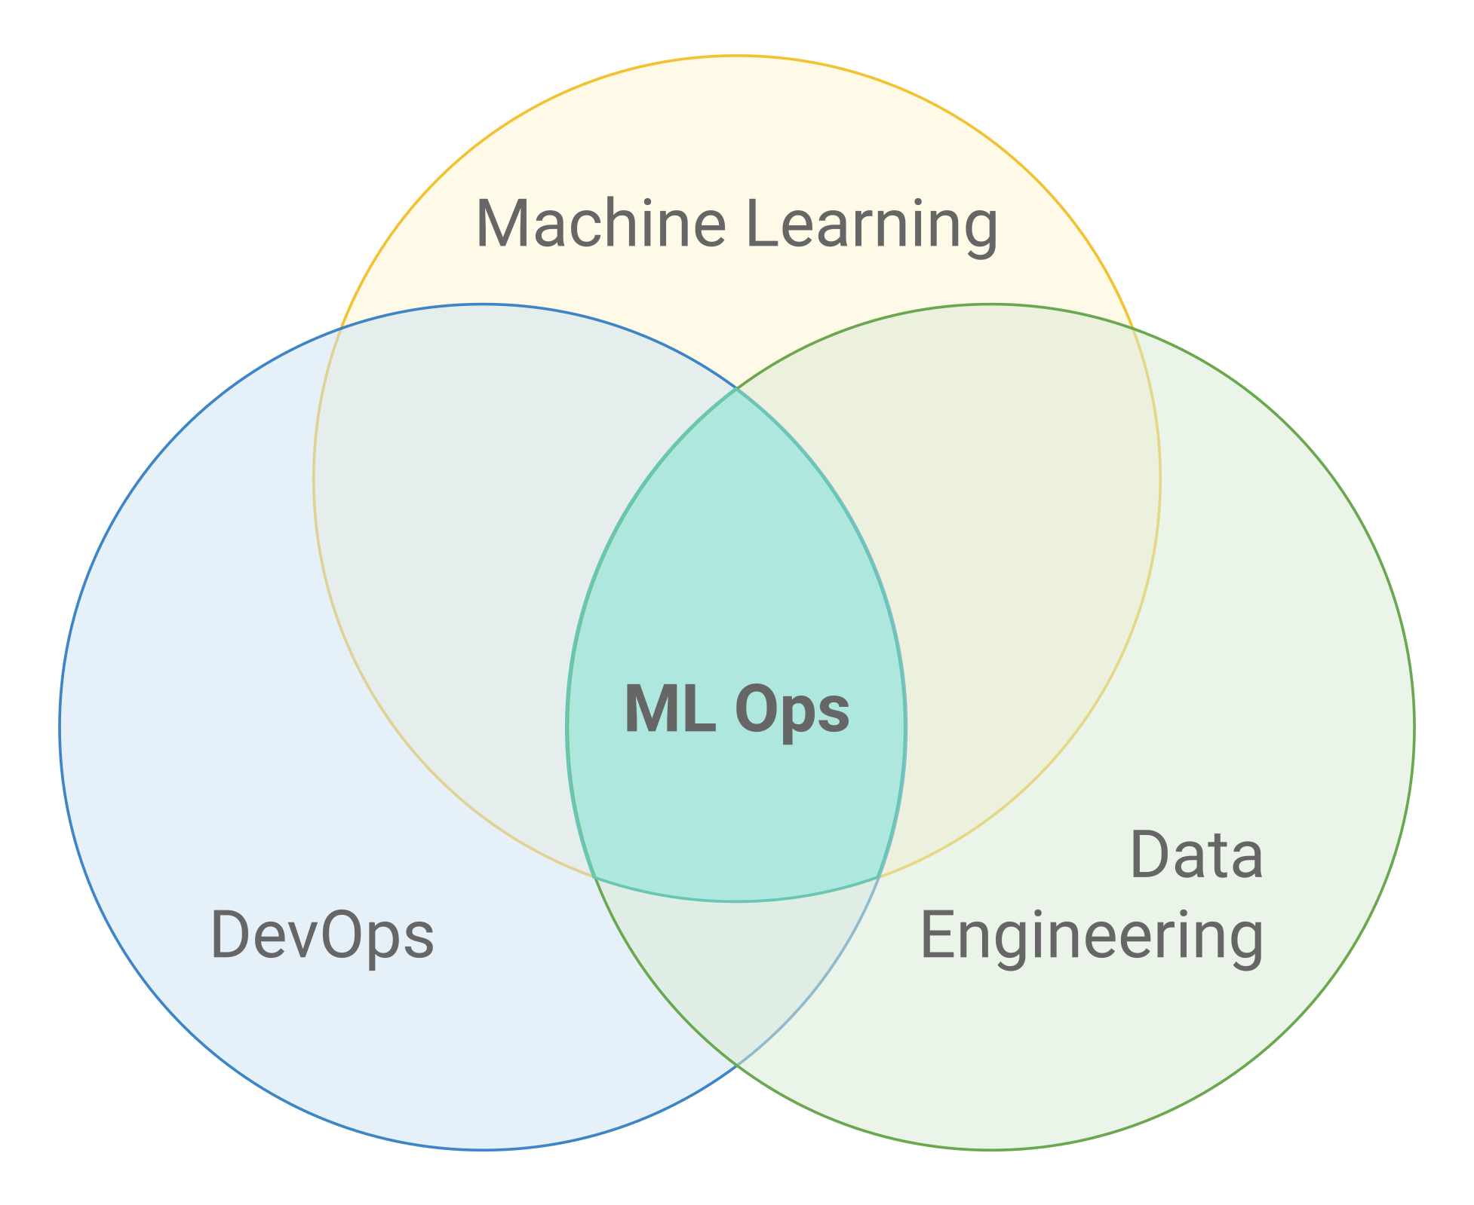
Focus Teaching: MLOps
ML is not just code, it’s code plus data
Notes:
Start with theme of how to show accountability and take initiatives and accepting your mistakes to take corrective actions

Slide 7
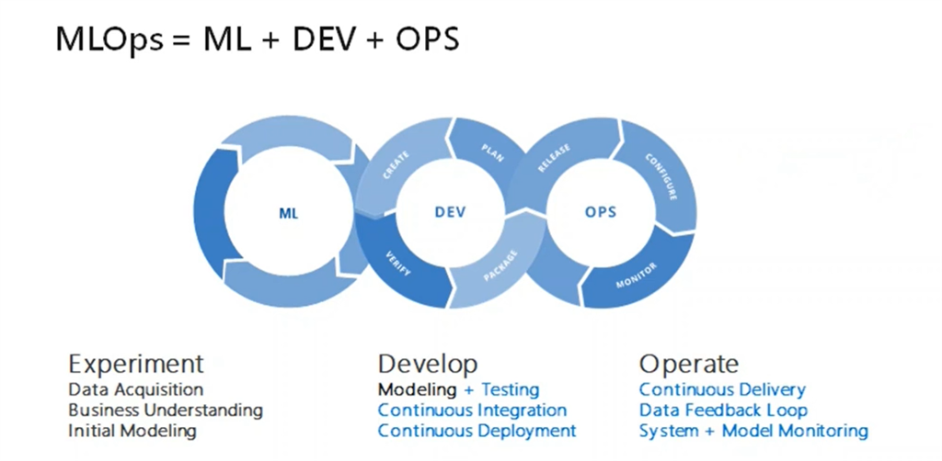
Focus Teaching: MLOps
Notes:
Start with theme of how to show accountability and take initiatives and accepting your mistakes to take corrective actions

Slide 8
Focus Teaching: MLOps
Data Science Steps
Data extraction
Data analysis
Data preparation
Model training
Model evaluation
Model monitoring
Model validation
Model serving

Slide 9
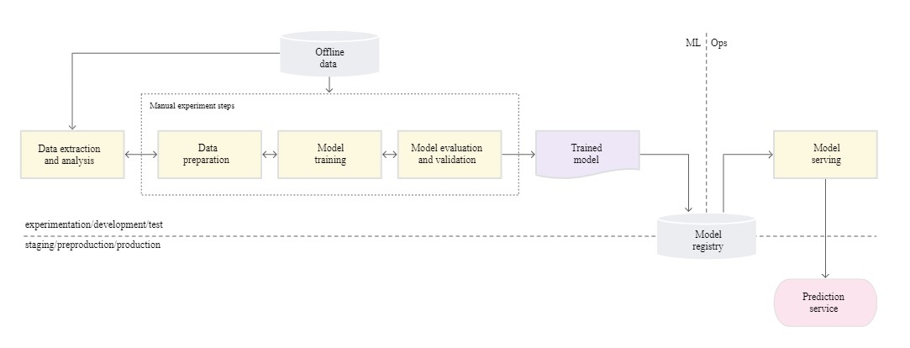
Focus Teaching: MLOps-level-0

Slide 10
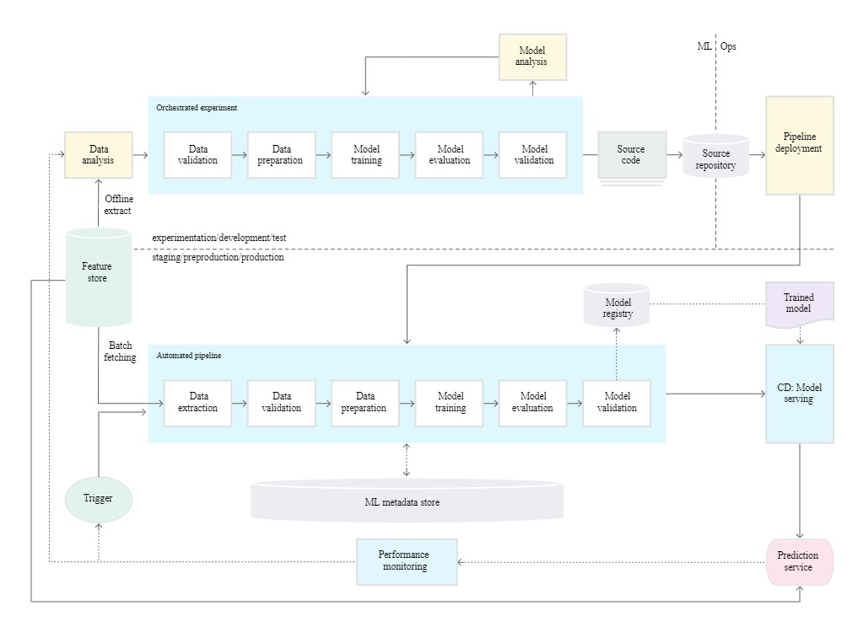
Focus Teaching: MLOps-level-1

Slide 11
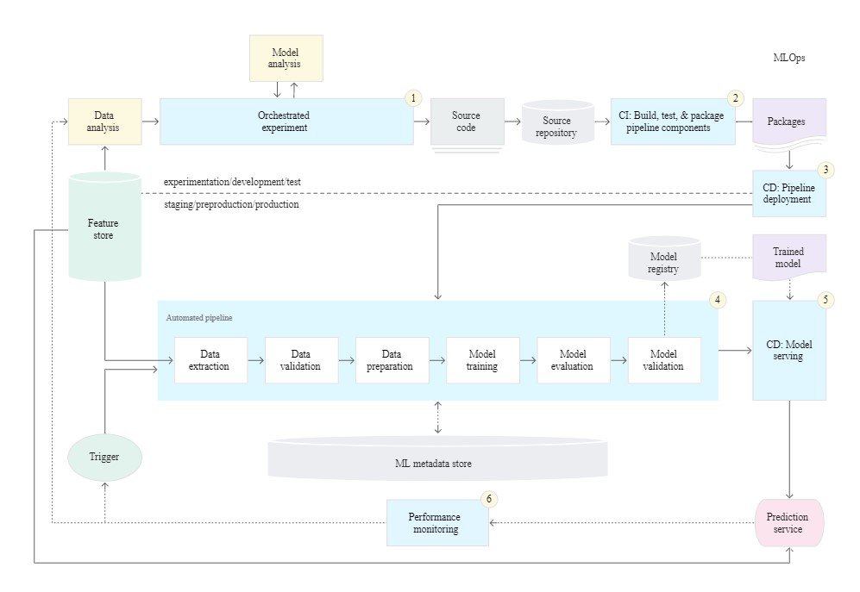
Focus Teaching: MLOps-level-2

Slide 12
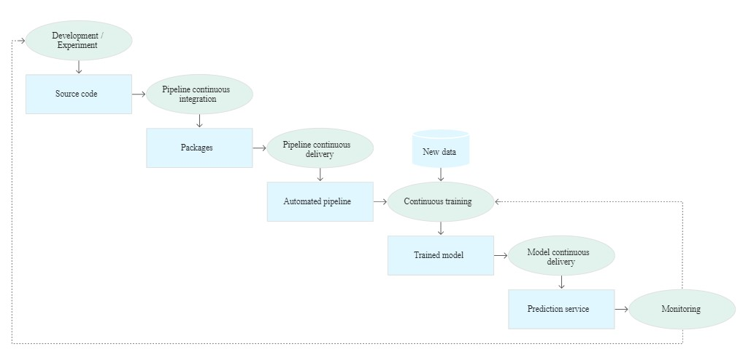
Focus Teaching: MLOps-level-2

Slide 13
Focus Teaching: MLOps Tools
Tools for MLOps
MLFlow
Pachyderm
Kubeflow
Algorithmia
DataRobot

Slide 14

Questions

